Slide 1
Project 2 - Bechdel Movie Test
Sophie Chance, Maureen Fromuth, Michelle Sinani

Slide 2

The TEST
Notes:
Background -
Era in which the aim for female representation across all niches to hit an all time high
Important to understand how those females are being represented, especially in pop culture
Represents to the younger generation and the world how our culture views the female role in society
Bechdel Test -
1985 a measure known as the Bechdel Test emerged
Evaluated the representation of when in film and other fiction
Became more widely discussed in the 2000’s and continues today
Measures the representation of women in film in the three following categories – to pass needs to satisfy all requirements

Slide 3

The Questions
What features of a movie are most important to that movie passing the Bechdel test.
Notes:
Overall – what features of a movie are most important to that movie passing the Bechdel test.
Identify patterns that would be identifiable across the film industry and look for strong correlations with Bechdel scores
Two components of analysis -
Analyzing general trends and
Assessing correlation between the Bechdel score and the different features of a movie
Trend Analysis -
Changes in Bechdel Scores Pass Rate Over Time
Genres with Highest Pass Rate; with Lowest Pass Rate
Most Common Plot Topics with Passing Bechdel Scores; with Failing Bechdel Scores
Movie Rating vs. Bechdel Scores
Correlation Analysis -
Revenue & Bechdel Score
Budget & Bechdel Score
IMDB Score & Bechdel Score
Sub-questions -
What is the average IMDB score of a movie that passes the Bechdel test as compared to the average IMDB score of a movie that fails the Bechdel test?
What is the difference in gross revenue for a movie that passes the Bechdel test as compared to a movie that fails the Bechdel test?
Which directors have the highest percentage of Bechdel passing movies as compared to which directors have the lowest percentage?
How many of the top 5 directors with passing Bechdel tests are male vs. female?
How many of the top 5 actors in passing Bechtel tests are male vs. female?

Slide 4
THE DATA
IMDB ID
(imdbid / float)
Bechdel Score
(rating / integer - 0 to 3)
IMDB 5000 Movie Dataset
Bechdel Score (rating / integer - 0 to 3)
Movie Bechdel Test Scores
Revenue (gross / integer - null to 760505847)
Rating (content_rating / string - R, PG-13, PG, Not Rated, G)
Genre (genre / string)
Budget (budget / integer - 218 to 12.2Bill)
IMDB Score (imbd_score / float - 1.6 to 9.5)
Directors (director_name / string - multiple)
#1 Actor (actor_1_name / string - multiple)
Year Released (title_year / integer - 1916 to 2016)
Plot Keywords (plot_keywords / string - multiple)
IMDB ID (movie_imdb_link / string)
Notes:
General –
Two datasets
Bechdel:
9,372 entries
9 unique variables/columns
Release dates from 1874 to 2021
Test score numbers 0 to 3
IMDB:
5,042 entries
28 unique variables/columns

Slide 5
CLEANSING, TRANSFORMATION, and MERGING
IMDB Dataset
Removed extraneous characters from movie title and title year fields
Remove duplicates
Dropped irrelevant fields
Created cleaned dataframe
Bechdel Dataset
Created two new fields – Bechdel pass (Boolean) and IMDB ID (transformation from existing imdb column)
Remove duplicates
Dropped irrelevant fields
Created cleaned dataframe
Merge Datasets
On IMDB_ID
Removed all rows with Null values in key fields
Notes:
Deduplicate – looked all similar, so kept first one
Bechdel: went from 9373 to 9361
IMDB: went from 5043 to 4919
Cleaned up extraneous characters
Bechdel: ‘xa0’ from movie title; ‘.0’ from front of title year
IMDB: remove ‘.0’ from end of ID
Created two new columns
Pass – Boolean
New ID – removed the hyperlink and the TT
Merge
Merged on the IMDB_ID
Dropped any columns that had null values in it
Moved it from 9413 to 804 total; 139 from before 1916, and few null values = most was lack of overlap between two datasets

Slide 6
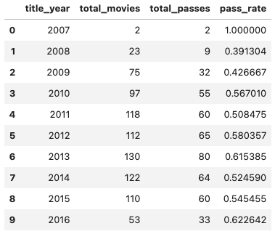
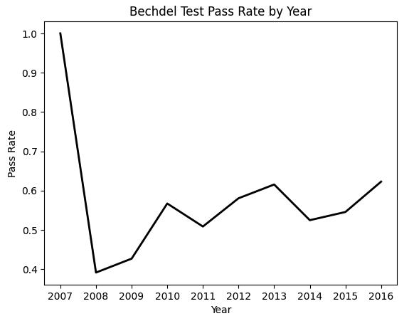
THE ANALYSIS PASS RATE BY YEAR
Notes:
-it is evident that passing rates almost consistently have been above 50% despite the years 2008 and 2009. It can be seen that in 2007 it is calculated that 100% of the movies passed the test, but taking note of the n=2 total movies makes us conclude this is relevant to the dataset and not as applicable to real life trends. Similarly, Figure 1.1, demonstrates the fluctuations with passing rates across the years. The 100% passing rate can be seen as the initial spike in the graph, but the sudden drop should be interpreted with caution.

Slide 7
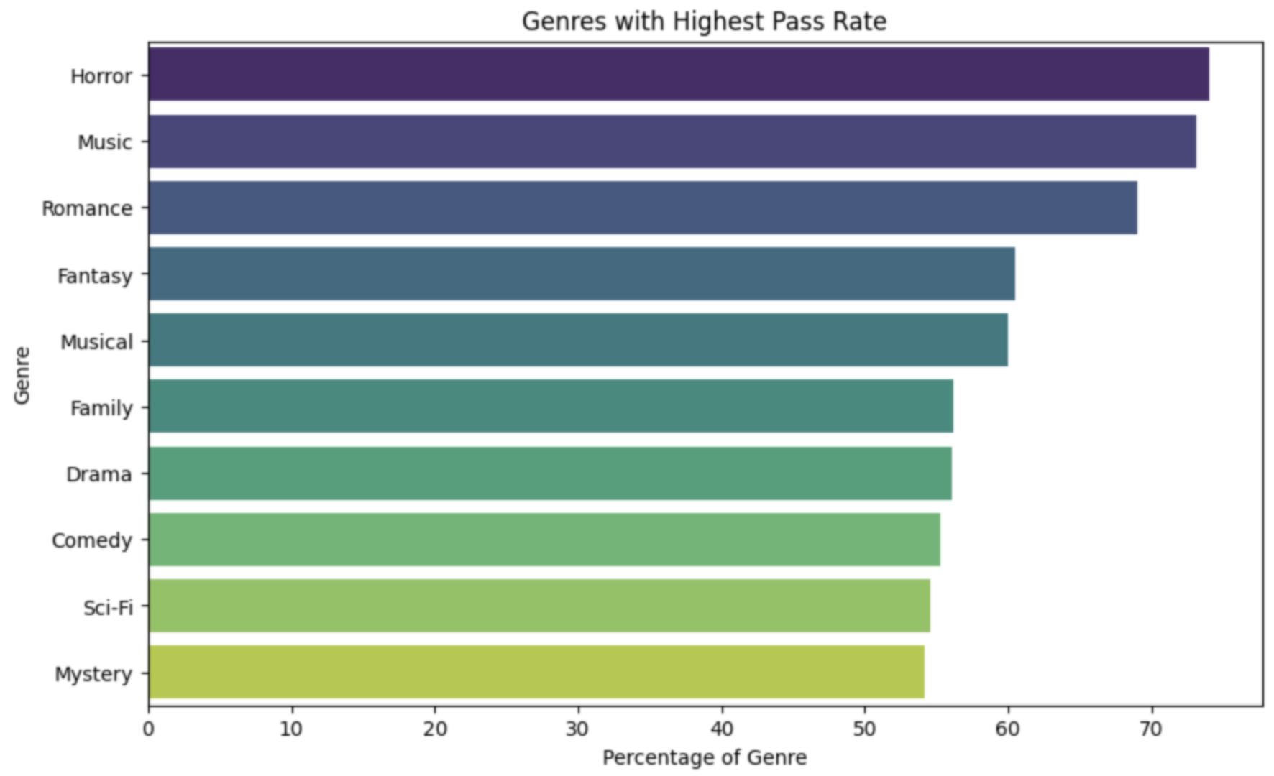
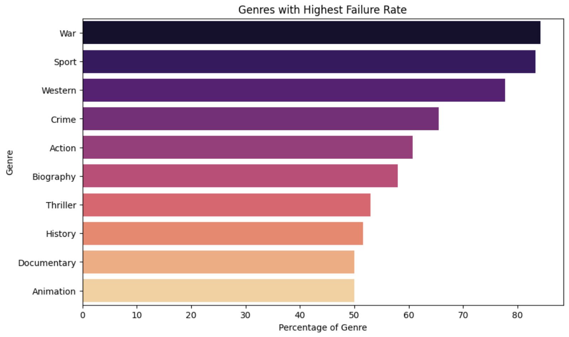
THE ANALYSIS GENRE & PASS RATES
Notes:
nearly 70% of both horror and music based movies had a passing Bechdel score. Closely following these genres are romance, fantasy, musical, and family, which may be explained by the tendency for such films to be targeted towards the female population.

Slide 8
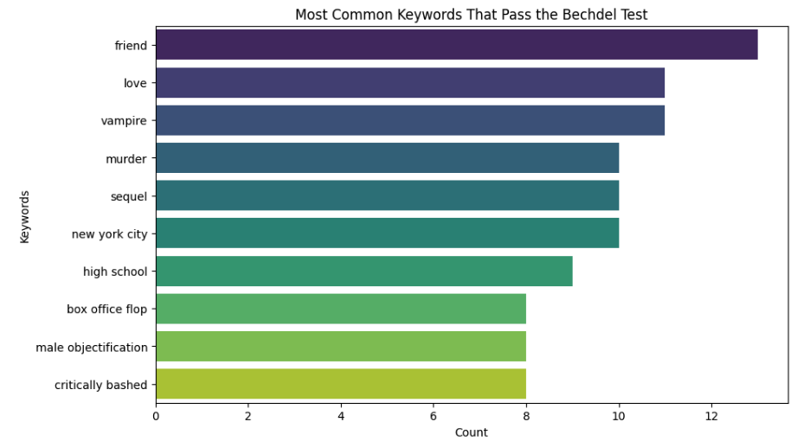
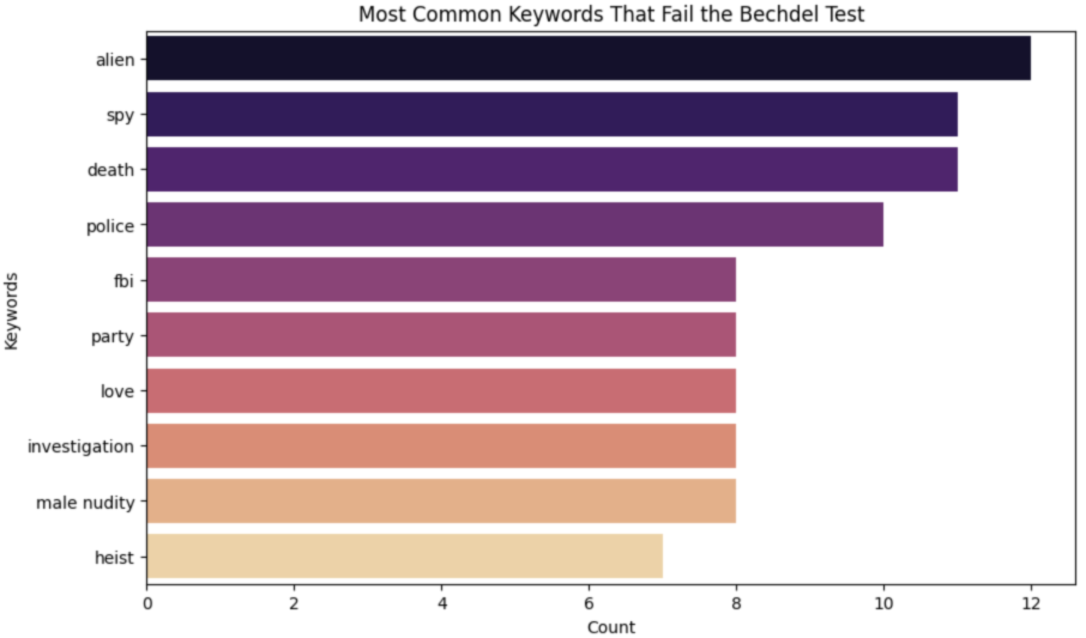
THE ANALYSIS KEYWORDS & BECHDEL PASS COUNT
Notes:
-Movies with keywords such as friend, love, vampire, male objectification, and high school tended to have higher counts of passing the Bechdel test
-Words such as alien, spy, death, police, and fbi are seamlessly aligned with the genres with the lowest passing rates which once again emphasize the focus towards a male centered movie approach.

Slide 9
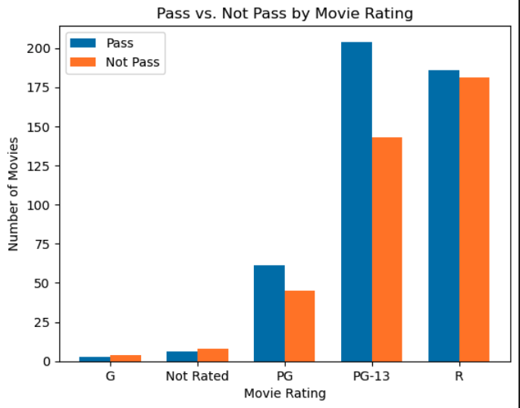
THE ANALYSIS MOVIE RATING & BECHDEL PASS COUNT
Notes:
-Rated R movies tended to have an equal distribution of passing and non passing Bechdel movie scores. In terms of PG and PG-13 rated movies, passing bechdel scores seem to push the equal distribution to a 60-40 representation instead
- not as much of a polarizing result as expected

Slide 10
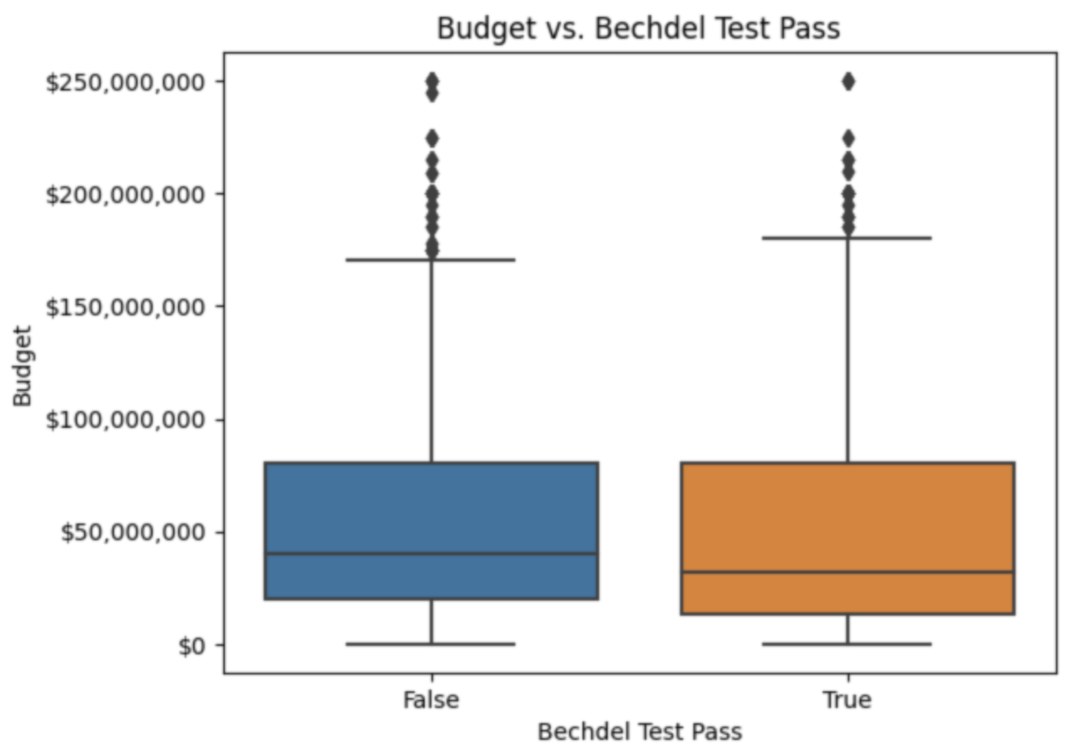
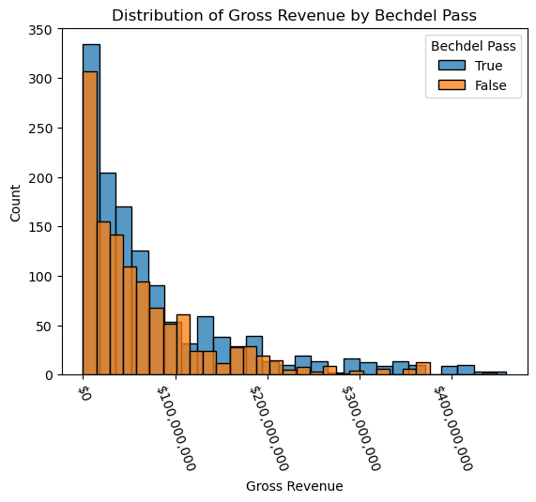
THE ANALYSIS REVENUE & BECHDEL SCORE
Notes:
-The existing data demonstrates that the impact of the outcome of the Bechdel test on gross revenue is statistically similar in regards to spread, but those that pass the Bechdel test have slightly higher measurements.
- both those that pass and those that fail have a relatively similar average with those that pass having a slightly higher mean. The quartiles and the max is also higher for those that pass the Bechdel test, but the min is lower.
Figure 5.1 confirms as well, that there are a greater number of passing movies with lower gross revenue, and those that pass the Bechdel test appear to have more outliers at higher revenues. Both distributions follow a skewed right model as expected with counts tailing off the higher gross revenues

Slide 11
THE ANALYSIS Budget & Bechdel Pass
Notes:
-Movies that pass or fail the Bechdel test have almost an identical interquartile range, with the maximum budget being slightly higher for movies that pass the test. Additionally, both instances contain several outliers within the spread of their data.

Slide 12
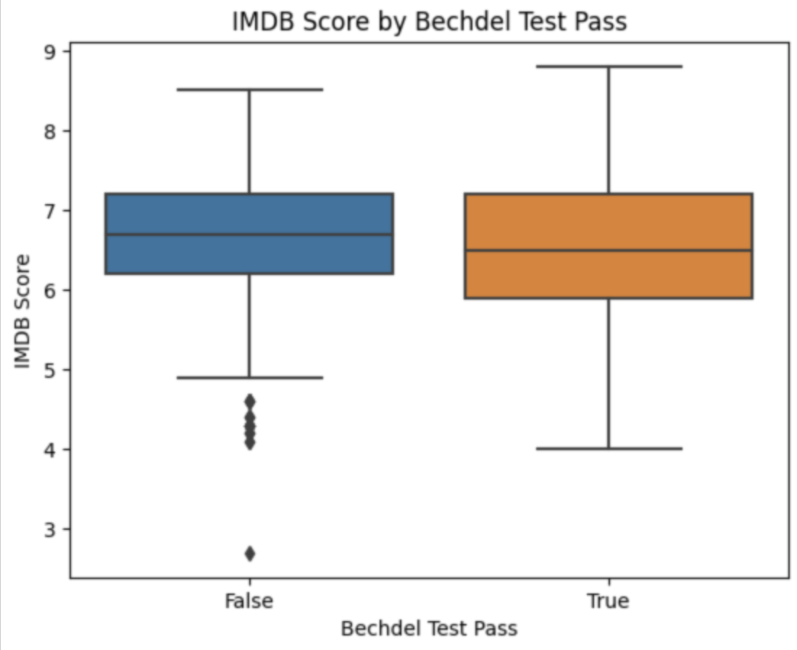
THE ANALYSIS IMDB Score & Bechdel Pass
Notes:
- it seems as if non-passing scores have a tighter spread ranging from an IMDB score of 5-9 with several lower bound outliers. In contrast, passing tests had an IMDB score spread from 4 to 9 with no outliers. Both have an average IMDB score around 6.75. Significant differences between the two boxplots are not demonstrated hinting at a Bechdel passing movie not having an attribute of a high IMDB score.

Slide 13
CONCLUSIONS
Findings do not indicate a strong relationship between the features of the movies we measured and the passing of the Bechdel test
Correlation analysis revealed very little correlation
Generally greater number of movies that passed in lower values, but higher outliers
Potentially larger spread in movies that passed
Unique findings in trend analysis, none indicated strong correlation between features and passing
Genre only had an approx. 20% split for movies that pass vs. 35% split with those that do not
Keywords had most promising notable trends, but hard to make conclusion on smaller dataset

